Slide 1
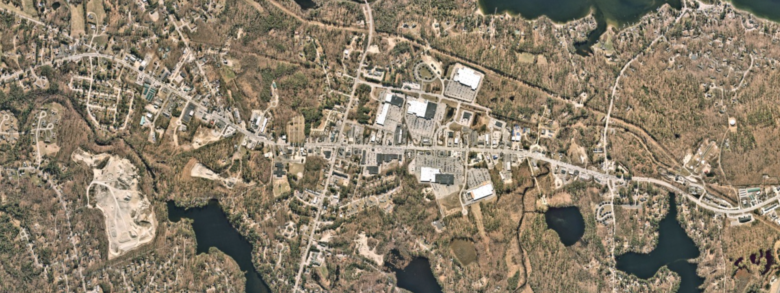


North Windham Improvements
Ernie Martin
MaineDOT
Downtown Projects Specialist
Ethan Flynn, P.E.
VHB
Director of Highway Engineering
Notes:
Ernie

Slide 2
Project area and descriptions
• Route 302 - Beginning at the River Road Intersection and extending northerly 1.7 miles to the Whites Bridge Road Intersection.
• Route 35 - Consist of Roadway Improvements from the Intersection of 35/115 (Boody’s Corner) extending westerly .33 miles to the Intersection of Manchester Drive
• Route 115 - Consist of Roadway Improvements from the Intersection of 35/115 (Boody’s Corner) extending easterly .45 miles to the Intersection of the new East Side Connector Road.
• Whites Bridge Road - Consist of Roadway Improvements from the Intersection of Route 302, extending westerly .33 miles to the New West Side Connector Road (Manchester Drive)
Notes:
Ernie

Slide 3
Project area and descriptions
• Construct an East Side Connector Road- Extend new road from Route 115 up to the termini of franklin Drive.
• West Side Connector Road- Consist of Roadway improvements on Manchester Drive from the intersection of Route 35 and extending .56 miles and a new road extending Manchester Drive northerly .55 miles to Whites Bridge Road.
• Middle Connector Road- Extends from the Intersection of Route 302/Franklin Drive to the Landing Road.
Notes:
Ernie

Slide 4
Introductions
Notes:
Ernie

Slide 5
Technical Presentation
Notes:
Ethan

Slide 6
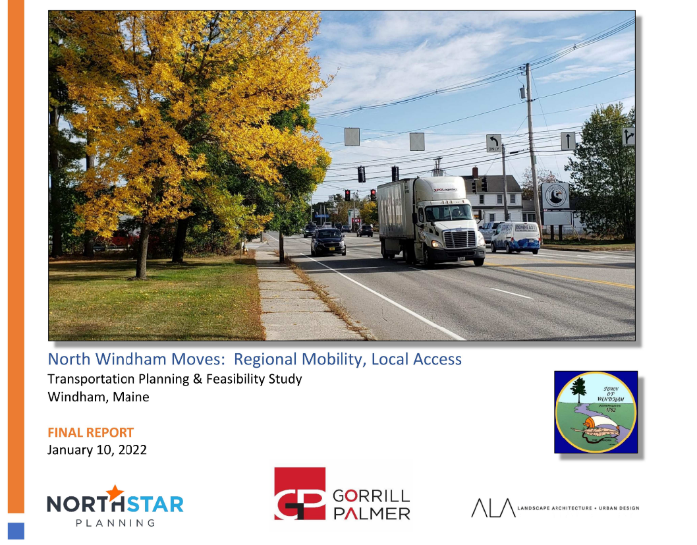
A continuation of north Windham moves
Notes:
This project is a continuation of the North Windham Moves Study that concluded in early 2022
Design is based on the recommendation of this study

Slide 7
A continuation of north Windham moves
The purpose of the North Windham Moves Study was to evaluate, analyze and improve local mobility and accessibility for the North Windham Downtown District while also providing for safety and mobility improvements for regional users along the Route 302 corridor.

Slide 8
A continuation of north Windham moves
The North Windham Moves Study enhanced and built upon the good ideas form prior studies.
Service Road Study – 2007
Lakes Region Transit Service Study – 2011
21st Century Downtown Plan – 2013
Multi-Modal Route 302 Corridor Plan – 2013
Lakes Region Bus Service Assessment – 2014
Town of Windham Complete Streets Policy – 2014
Town of Windham Comprehensive Plan – 2017

Slide 9
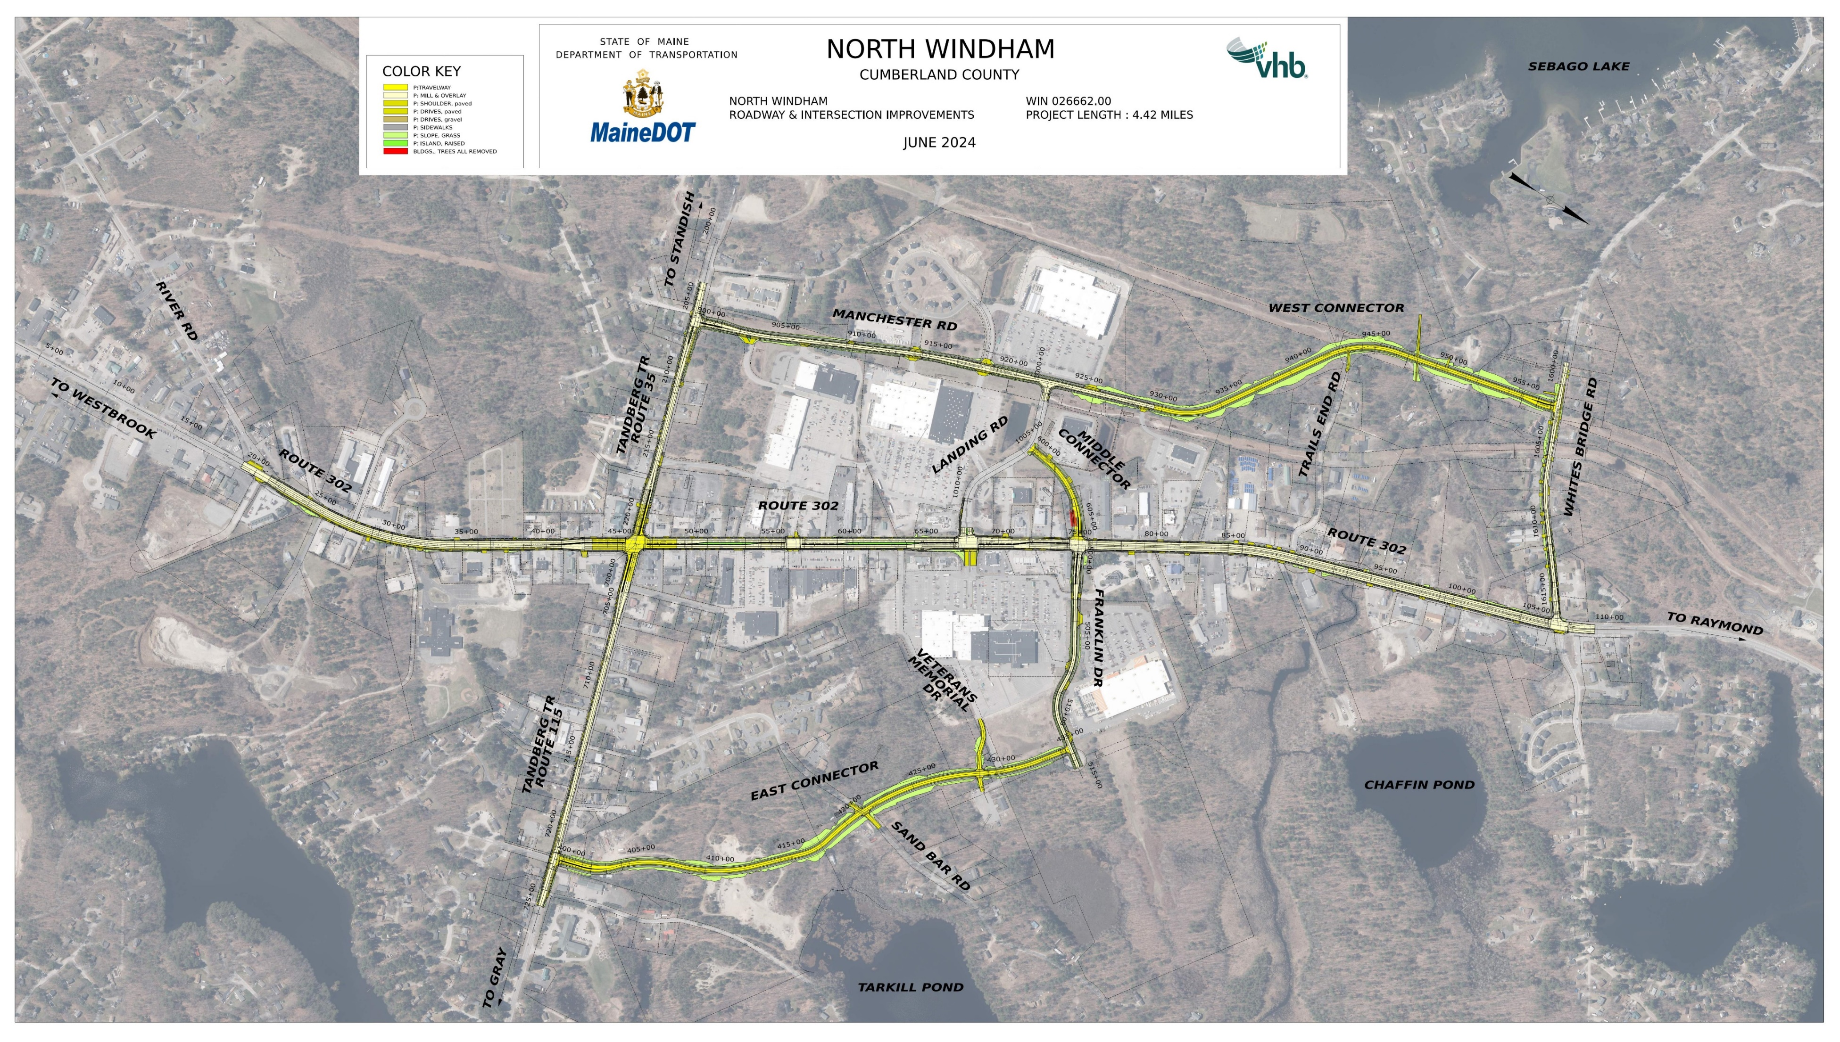
Notes:
Explain project limits
New connector roads will be local roads and 25 mph
Design is 25%
Landing Rd

Slide 10
Project Segments
Route 302 – 1.70 miles
Tandberg Trail – 0.79 miles
  Route 35 – 0.33 miles
  Route 115 – 0.46 miles
East Connector – 0.67 miles
Franklin Drive – 0.30 miles
West Connector – 1.00 miles
Middle Connector Rd – 0.14 miles
Landing Road – 0.24 miles

Slide 11
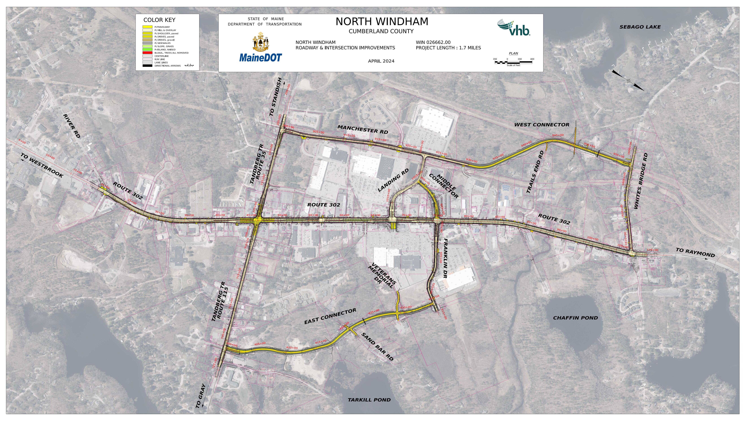
High Crash locations
Notes:
Starts are intersections
Red lines segments
Define HCL
On 302:
Left turns onto 302
Left turns off of 302
Rear ending folks waiting to make a left turn
Int of Abby Rd and Tandberg Tr
Turning movement into and out of Abby Rd
Int of 302 and Tandberg Tr
Lots of rear ends
Some left turns
Int of Manchester and Tandberg
Rear ends
Left turns in
Left turns out

Slide 12
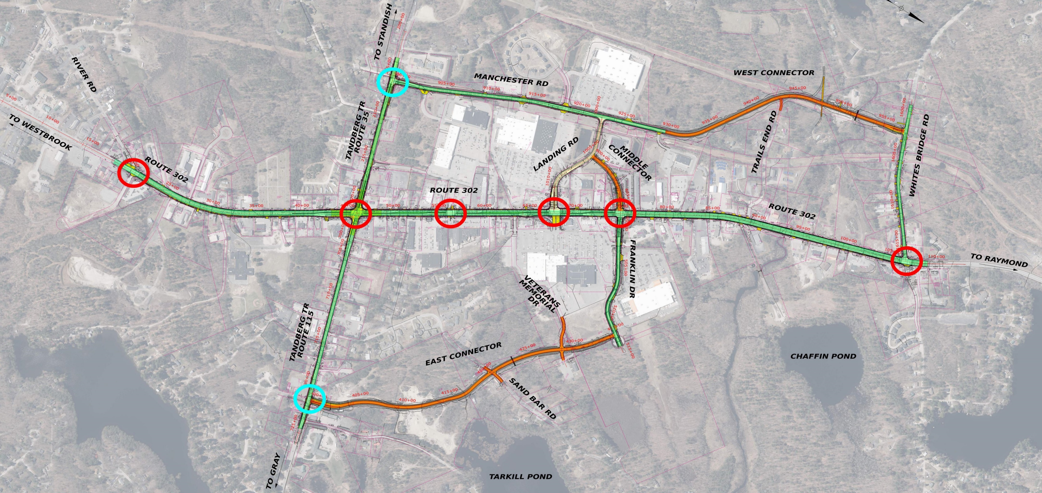
Notes:
Red lines = new roadway/full construction
Green line = mill and overlay
Adaptive signals w/preemptions
Red circles = existing signals upgrades
Blue circles = new signals

Slide 13
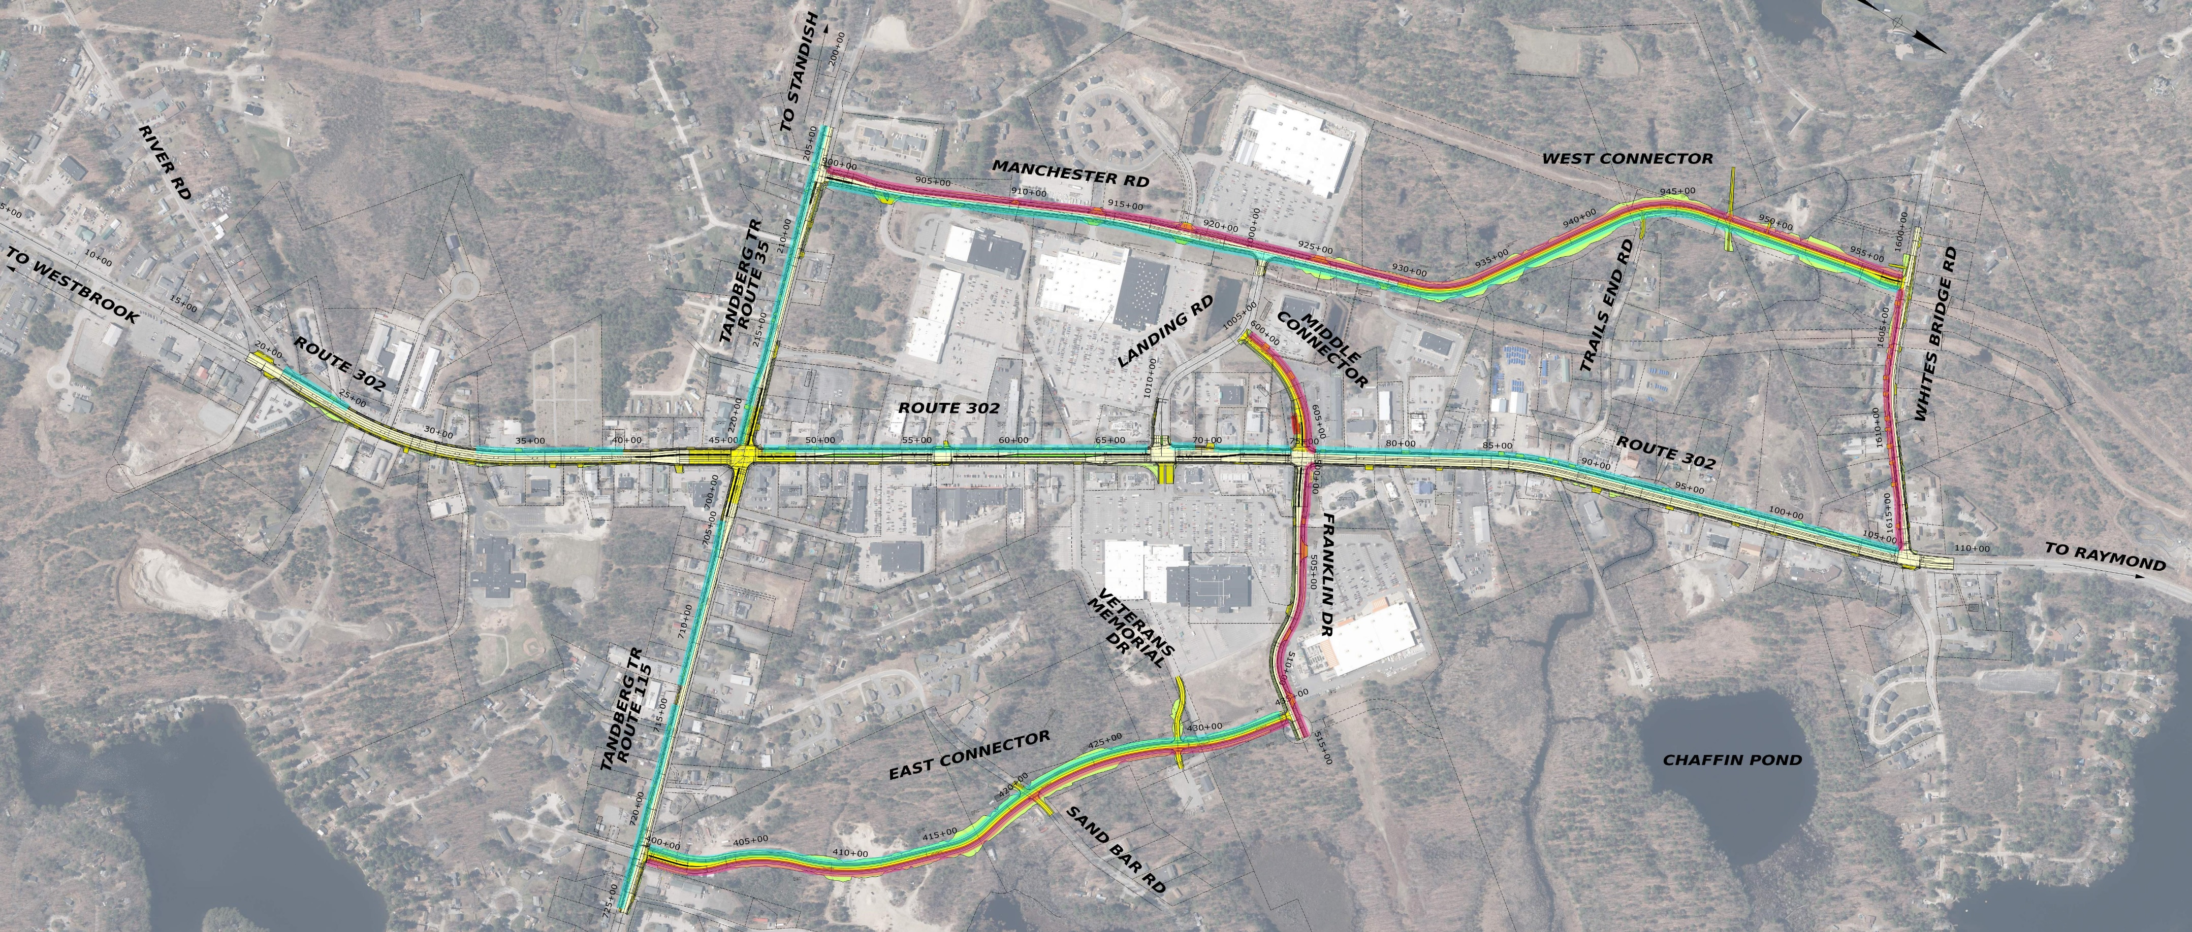
New Pedestrian facilities
Notes:
Pink lines = SUP
Blue = new SW
Pedestrian facilities on both sides of every road except Whites Bridge Rd and Landing Rd

Slide 14
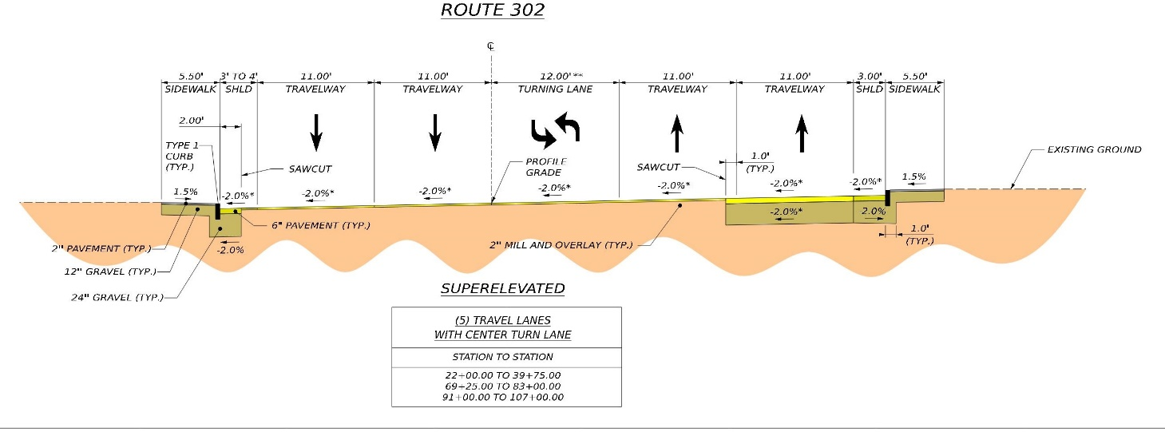
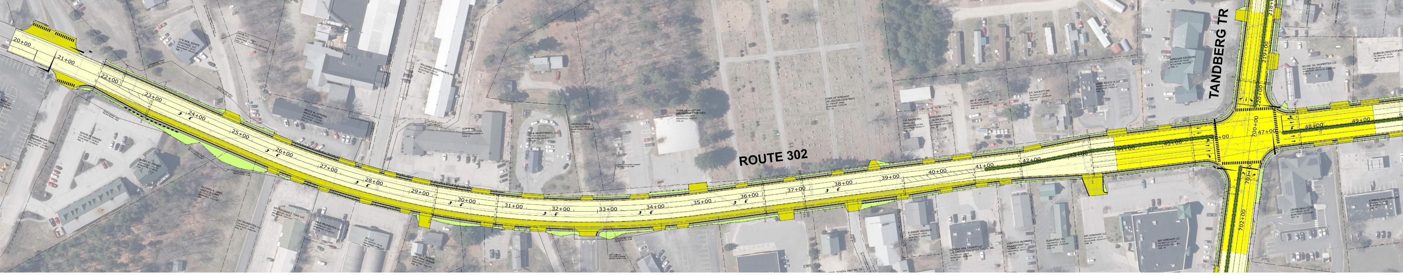
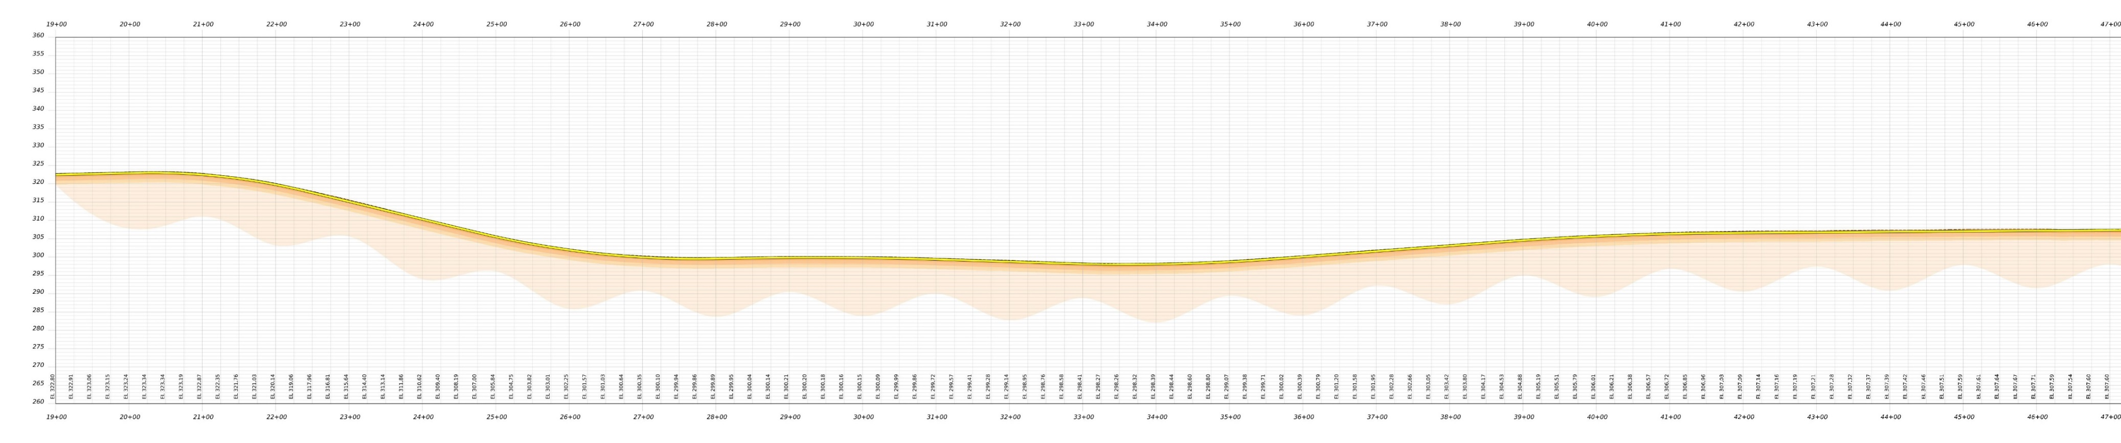
Route 302 – River rd to Tandberg tr
N
RIVER RD
Notes:
Explain colors
Mill and overlay
11’ TW , 12’ CTWLTL, 3’ SH
New lane Construction to provide for CTWLTL
New 5’ SW on the west side
Reconstruct 5’ SW on East side
New retaining wall by the Stockhouse Restaurant
New raised median extending back from the intersection of Tandberg Tr

Slide 15
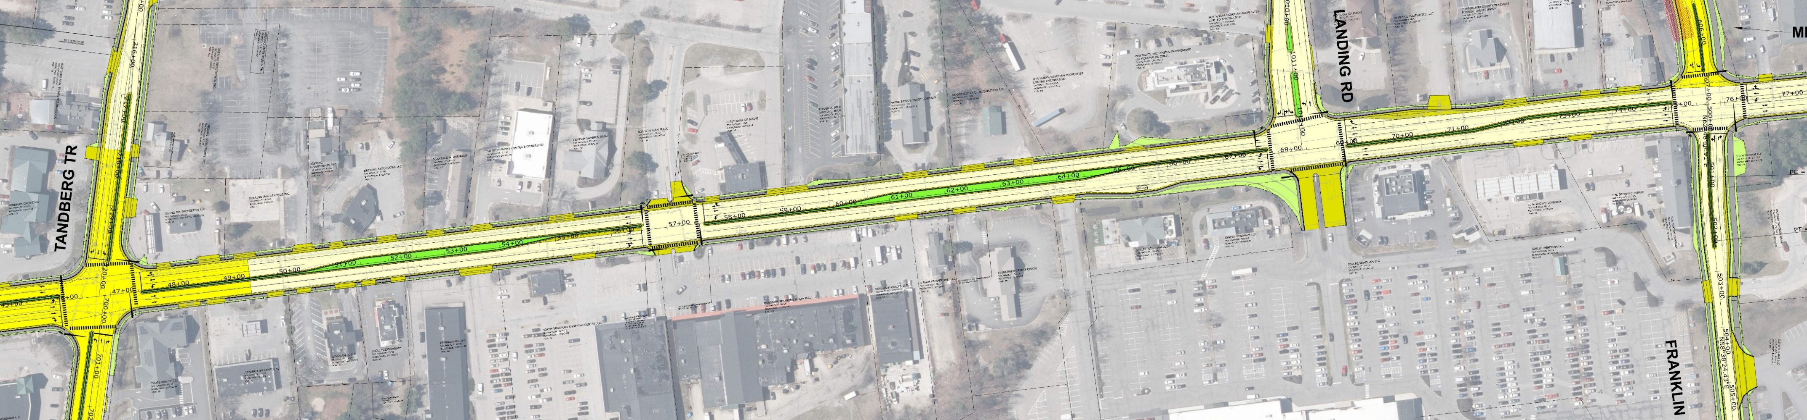
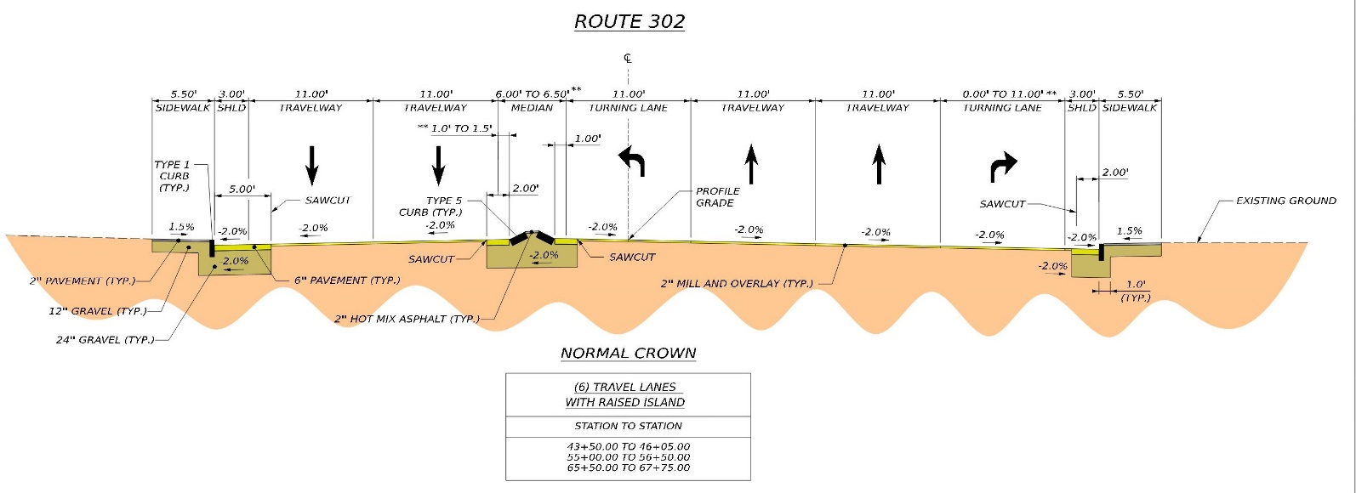
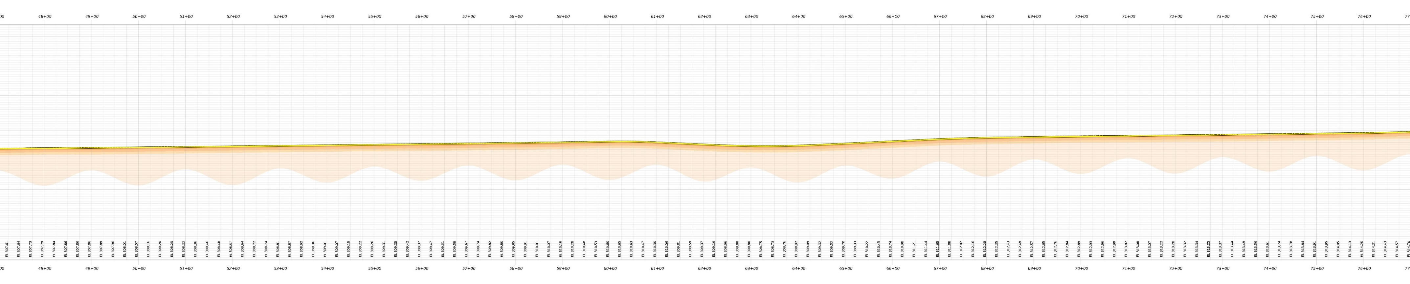
Route 302 – Tandberg tr to Franklin DR
N
Notes:
Mill and overlay
11’ TW , 3’ SH
New 5’ SW on the west side
Reconstruct 5’ SW on East side
New raised median extending to the intersection of Franklin Dr and the Middle Connector
Remove right-turn slip lane at Windham Mall and provide space for a bus stop

Slide 16
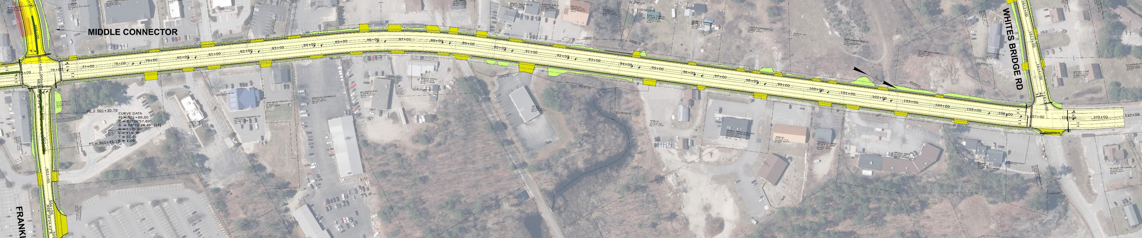
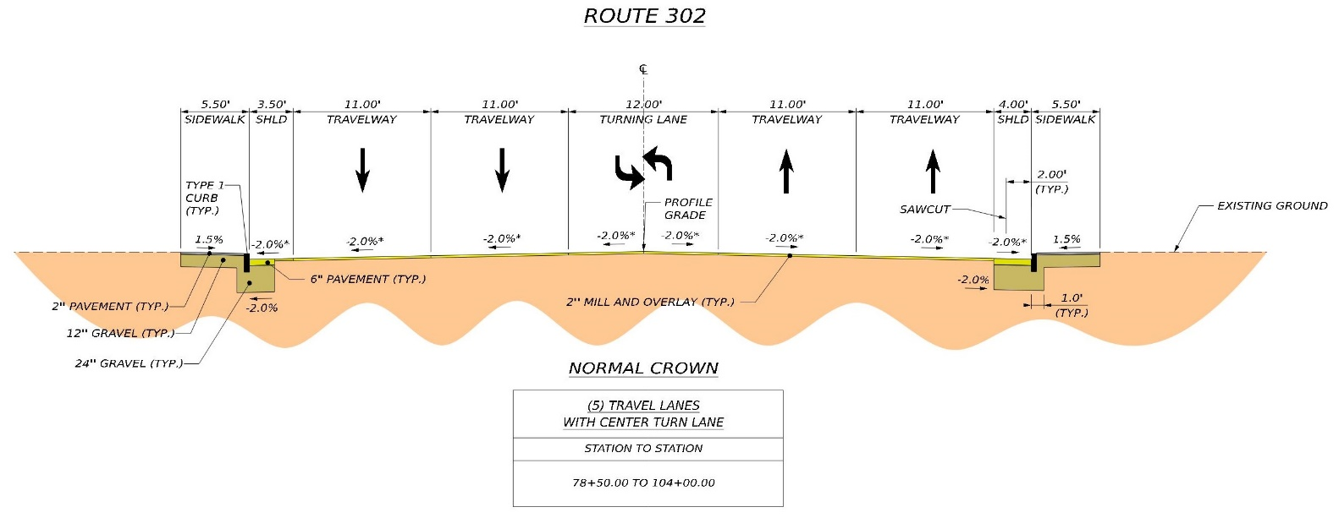
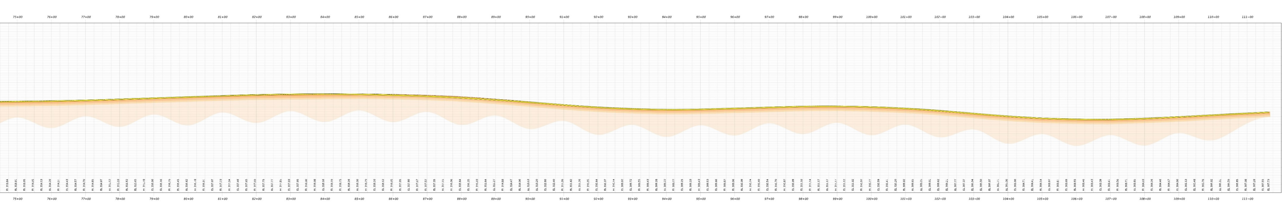
Route 302 – Franklin DR to Whites bridge rd
N
Notes:
Mill and overlay
11’ TW , 3.5’ to 4’ SH
New 5’ SW on the west side
Reconstruct 5’ SW on East side

Slide 17
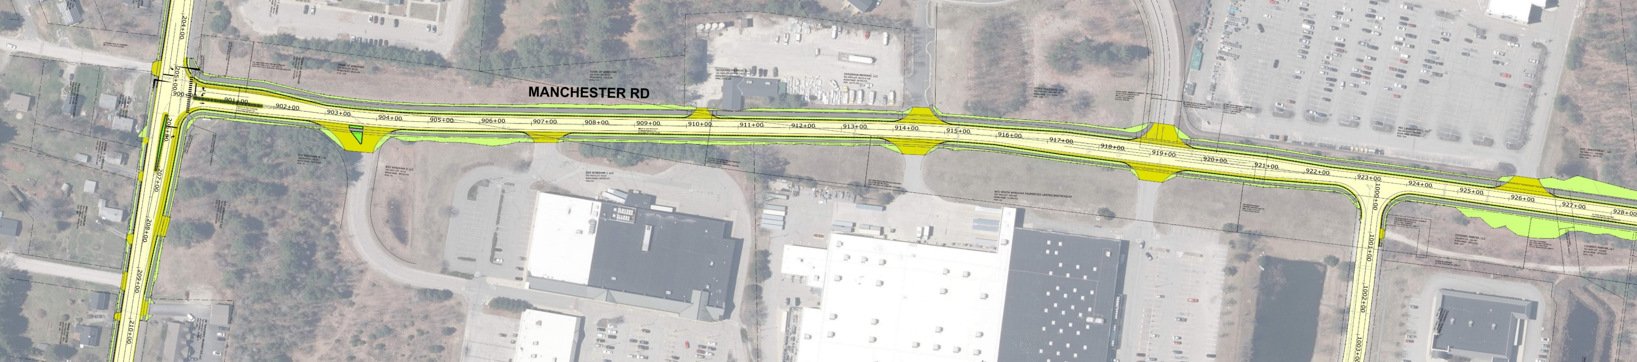
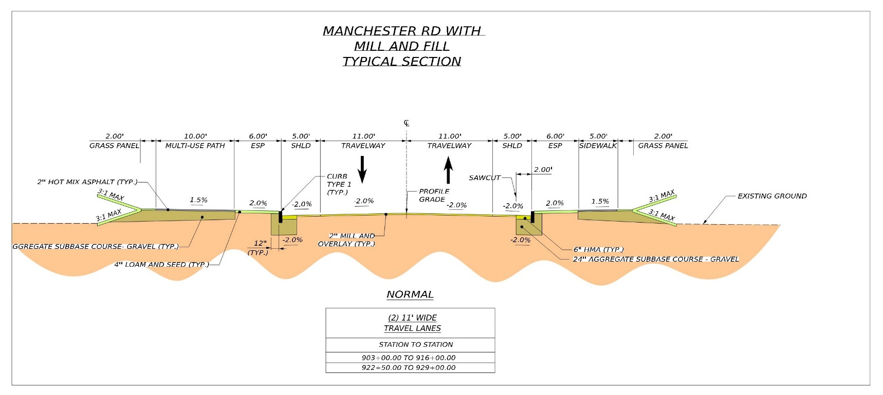
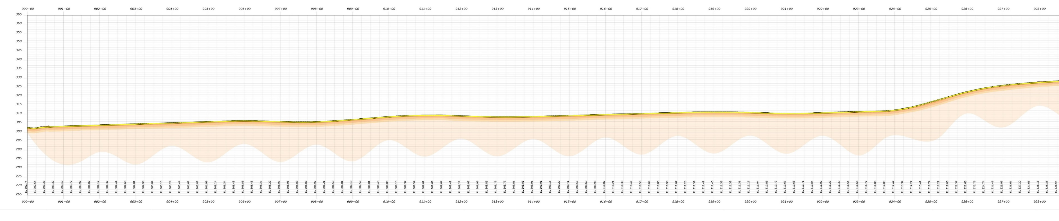
West Connector – Manchester rd
N
Notes:
Existing roadway section
Mill and overlay
11’ TW and 5’ SH
New 5’ SW and 10 shared use path w/6’ esplanade, curb, and drainage
New signal at the intersection of Tandberg Tr.

Slide 18
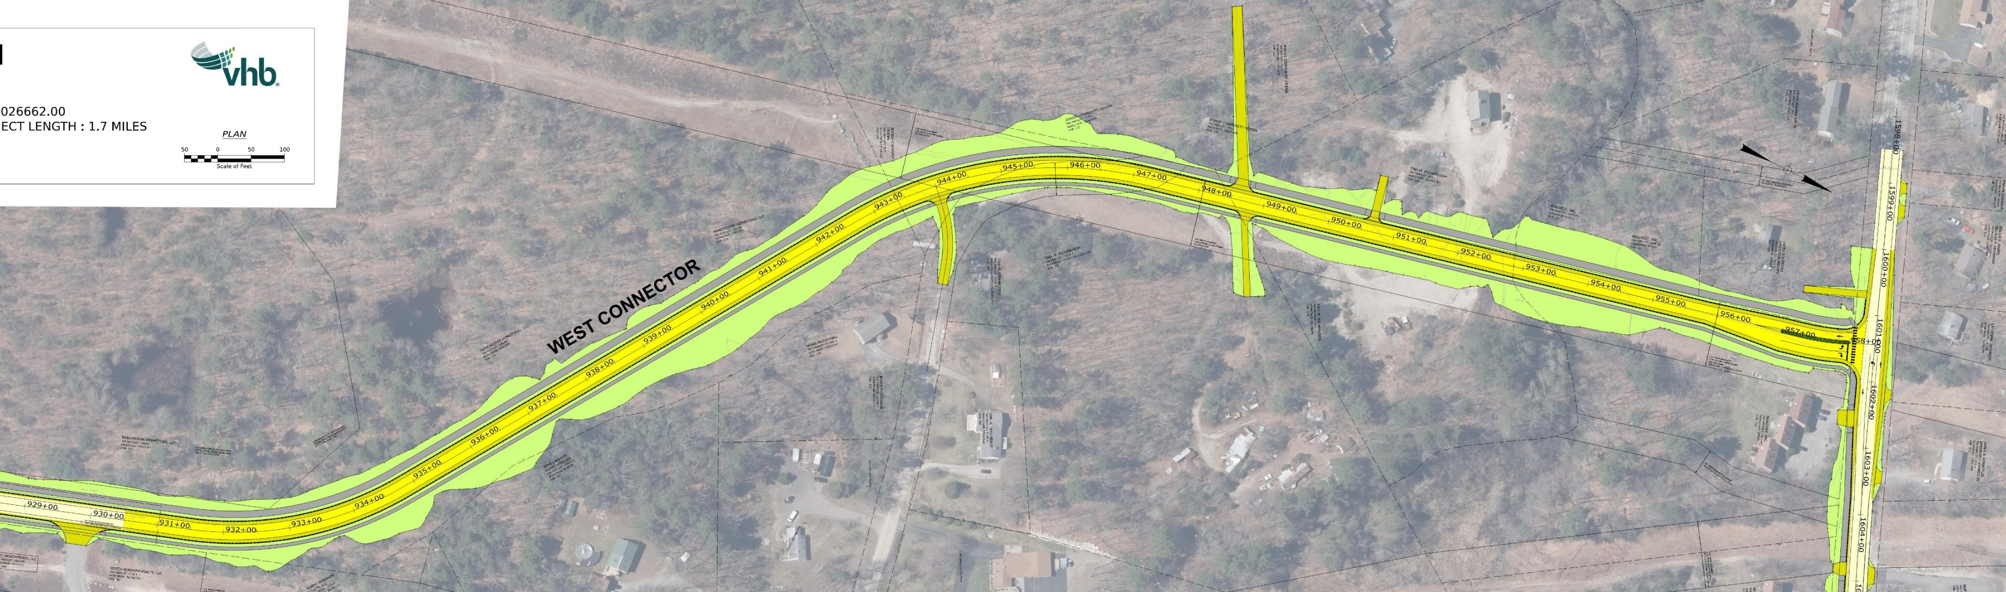
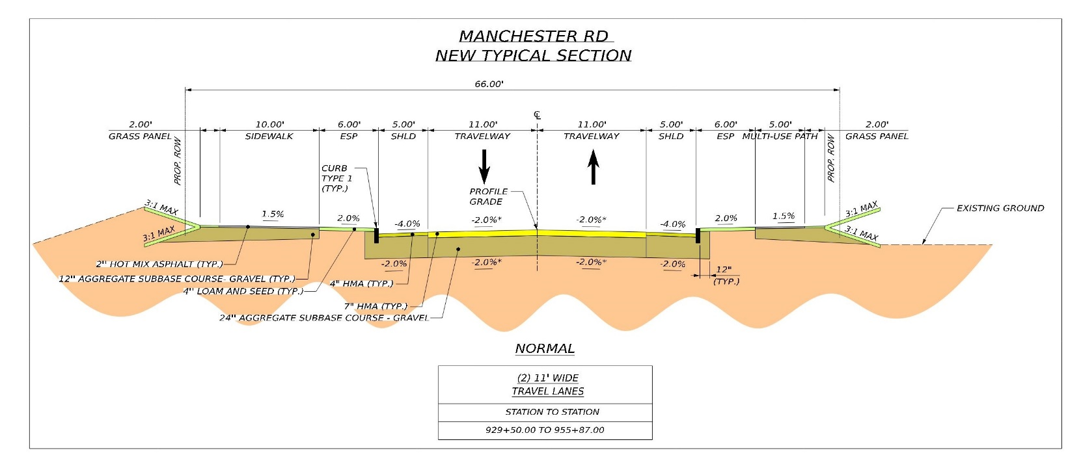
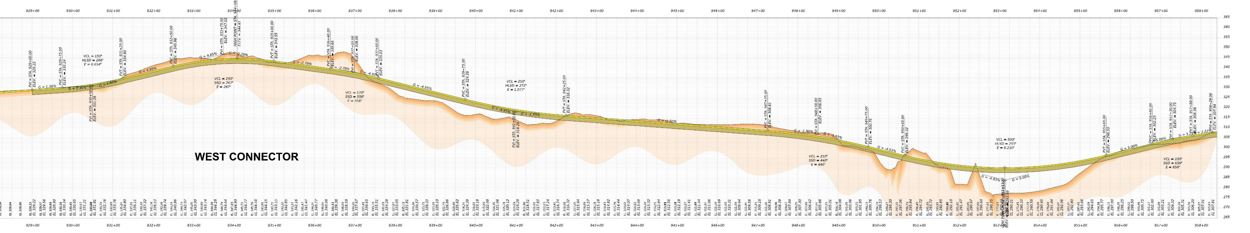
West Connector – New roadway
N
Notes:
New Reconstruction
11’ TW and 5’ SH
New 5’ SW and 10 shared use path w/6’ esplanade, curb, and drainage
New intersection at Whites Bridge Rd
Connection to Trails End Road
Stream crossing

Slide 19
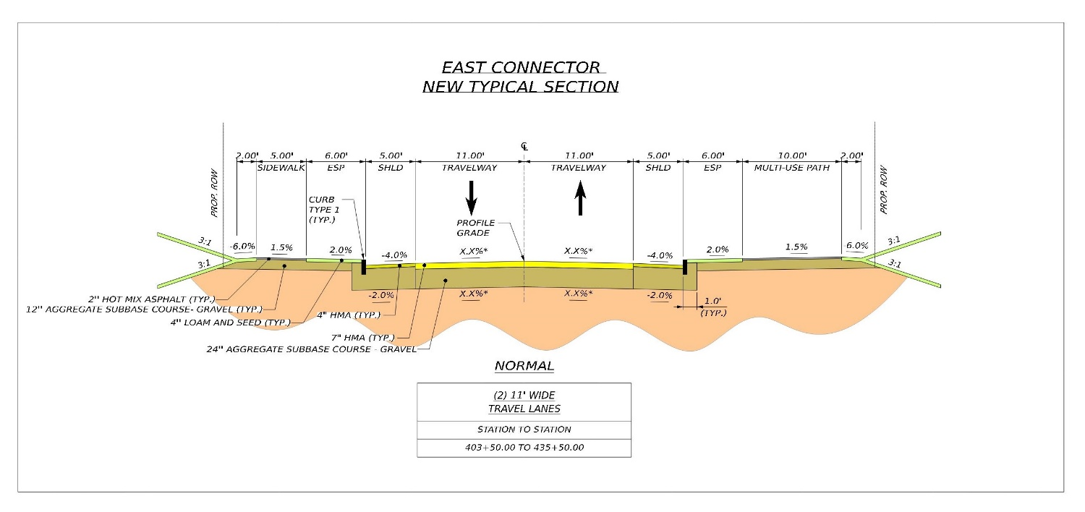
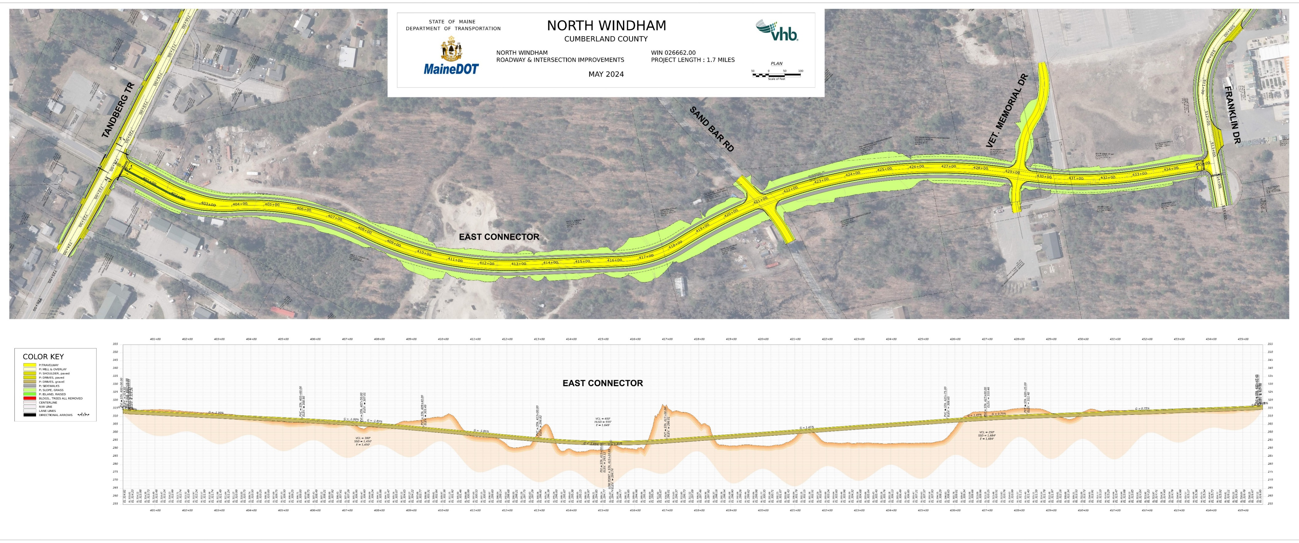
east Connector
N
Notes:
New Reconstruction
11’ TW and 5’ SH
New 5’ SW and 10 shared use path w/6’ esplanade, curb, and drainage
New signal at the intersection at Tandberg Trail
New intersection at Sand Bar Rd
Realign Veteran Memorial Dr
Flood plane crossing

Slide 20
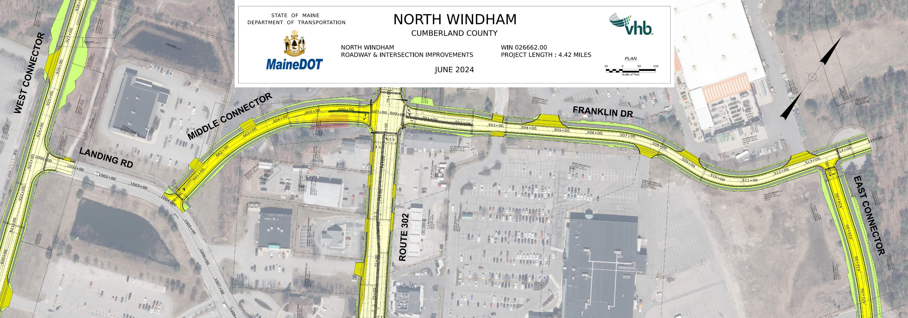
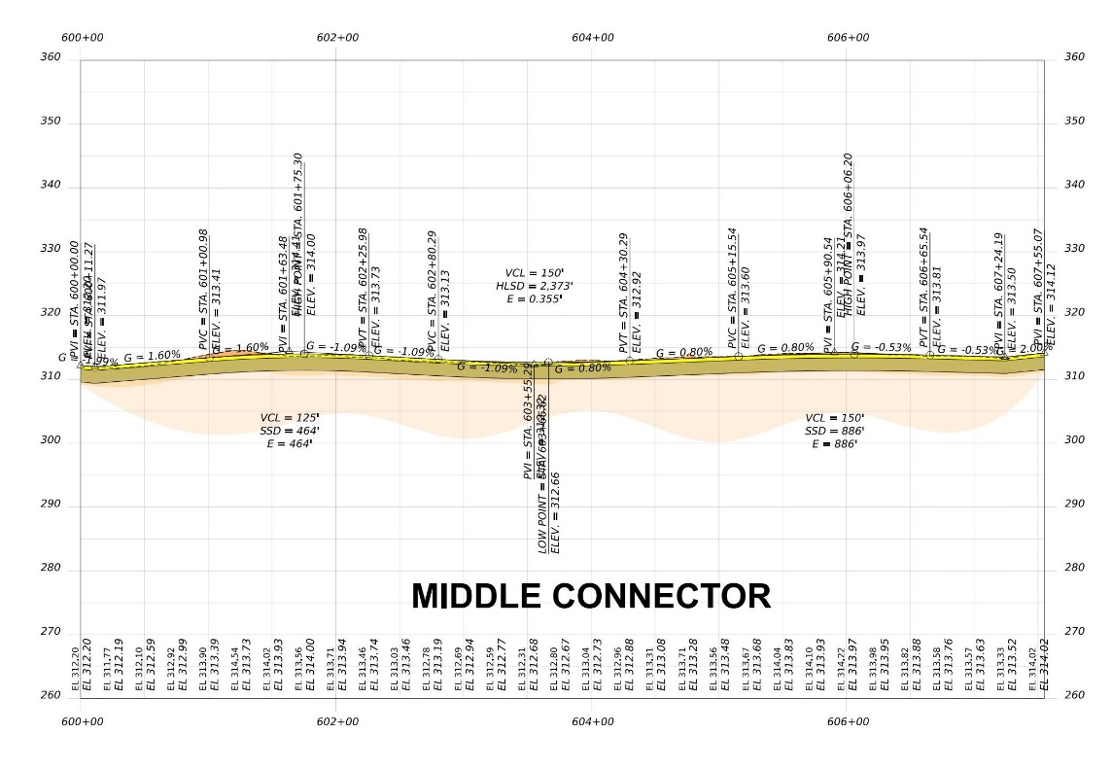
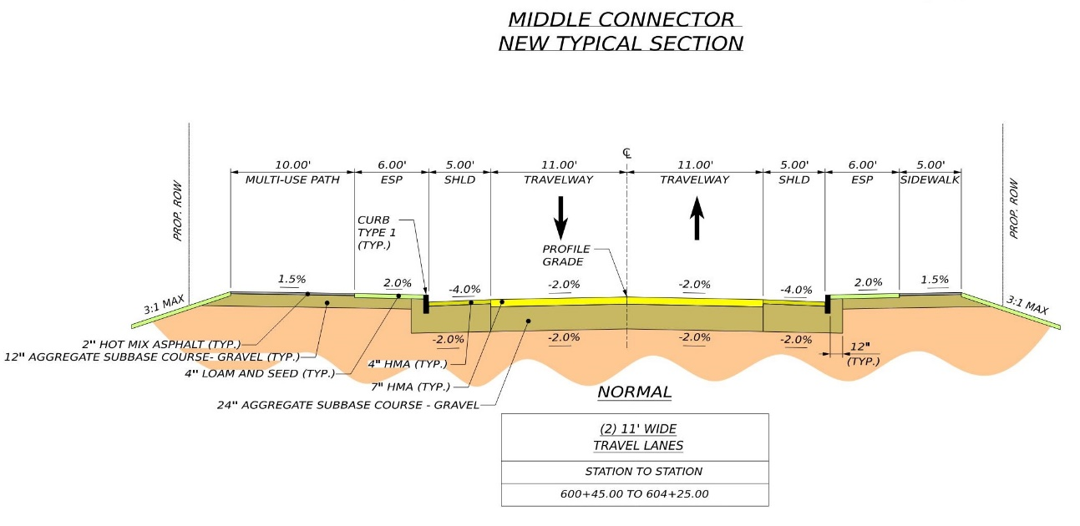
Middle connector & Franklin Dr
N
Notes:
Middle Connector
Raze Eagle Sushi + Steak house
New Reconstruction
11’ TW and 5’ SH
New 5’ SW and 10 shared use path w/6’ esplanade, curb, and drainage
New leg at existing signal at Franklin Dr
New intersection at Landing Rd
Franklin Dr
Mill and overlay
11’ TW and 3’ SH
New 5’ SW and 10 shared use path w/6’ esplanade, curb, and drainage

Slide 21
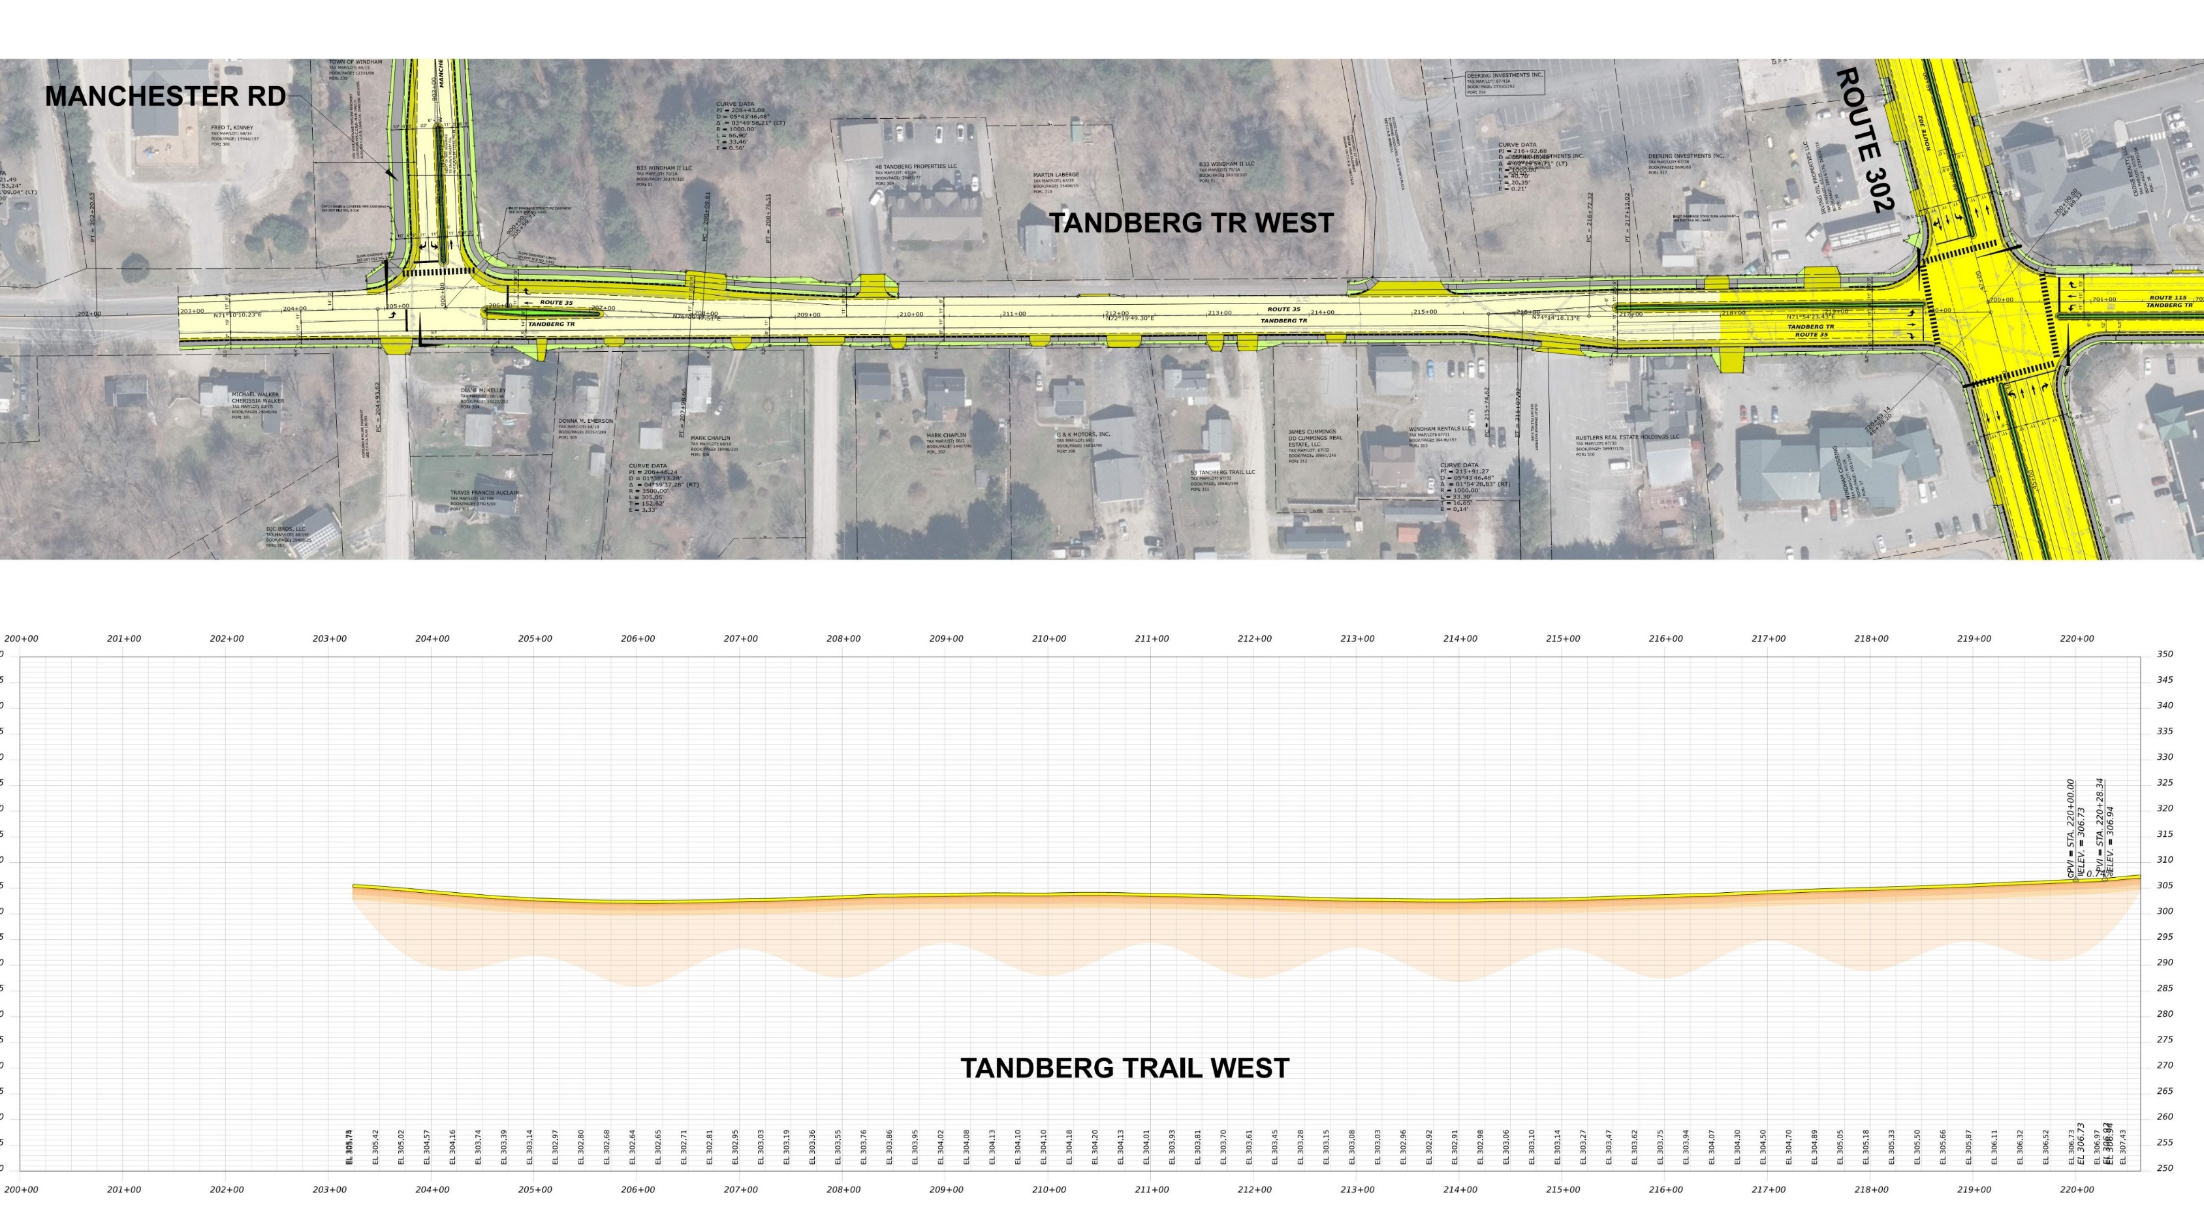
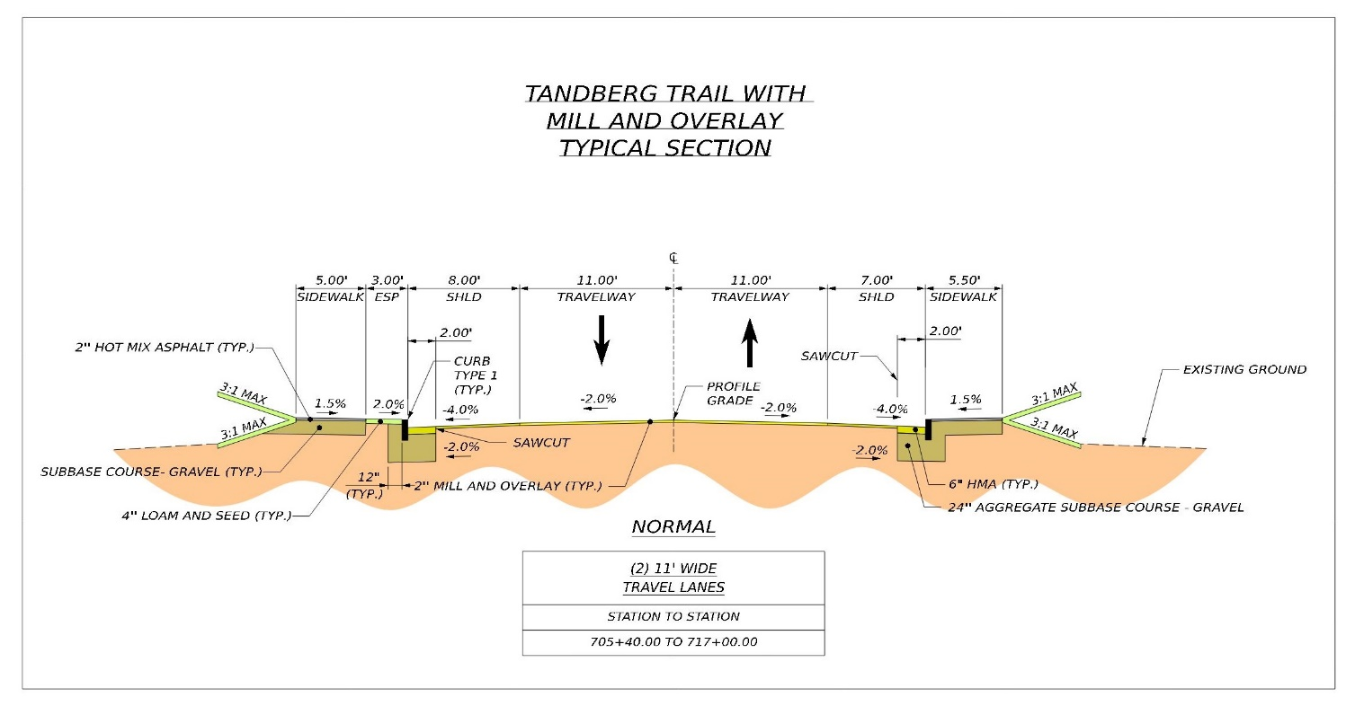
Tandberg trail - west
N
Notes:
Mill and overlay
11’ TW , 8’ SH
New 5’ SW on the south side
New raised median extending back from the intersection of Route 302

Slide 22
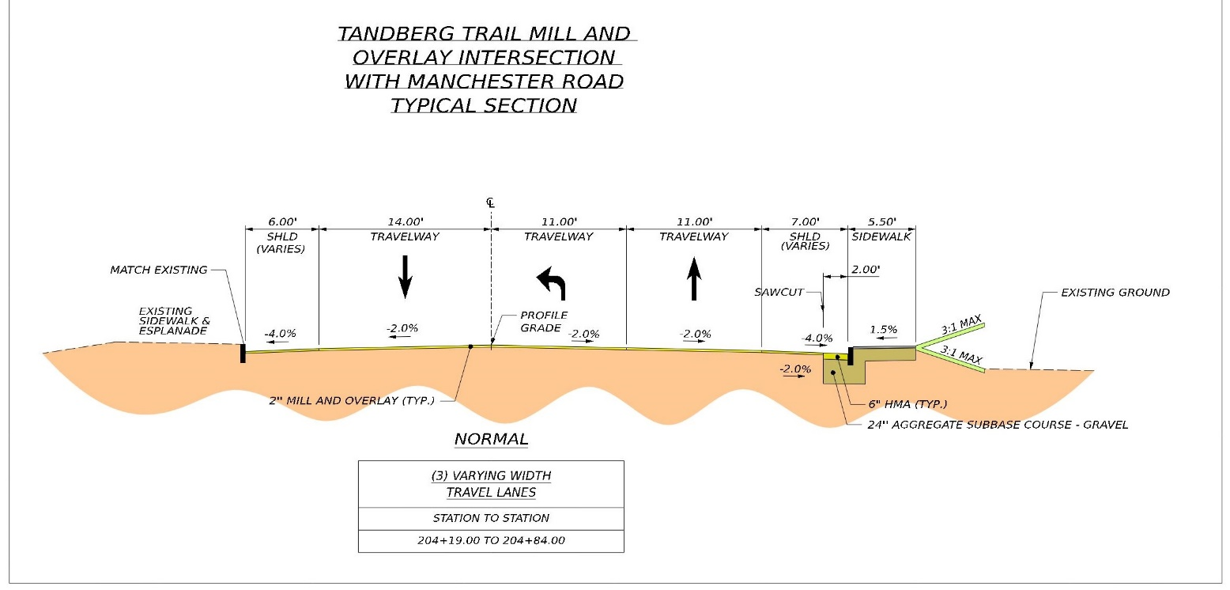
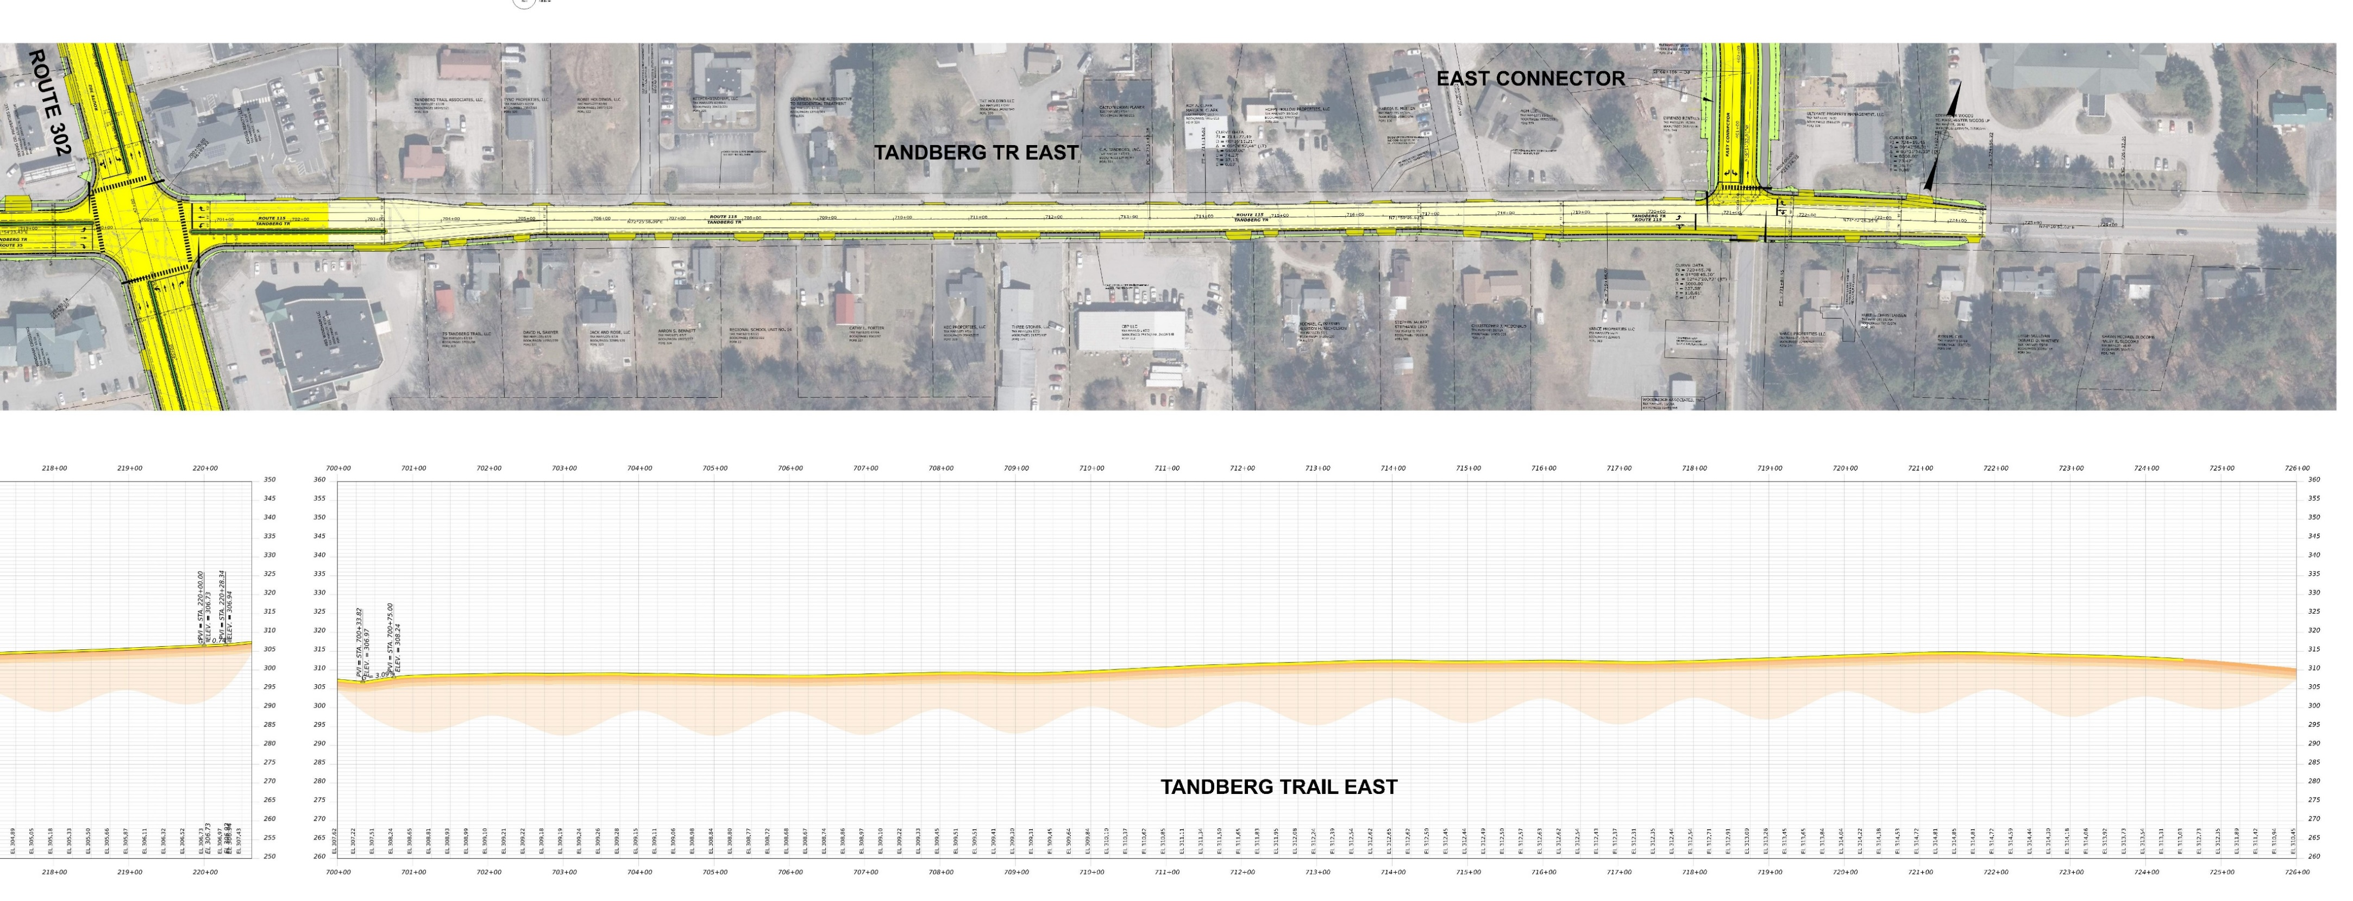
Tandberg trail - east
N
Notes:
Mill and overlay
11’ TW , 6’+ SH
New 5’ SW on the south side
New raised median extending back from the intersection of Route 302

Slide 23
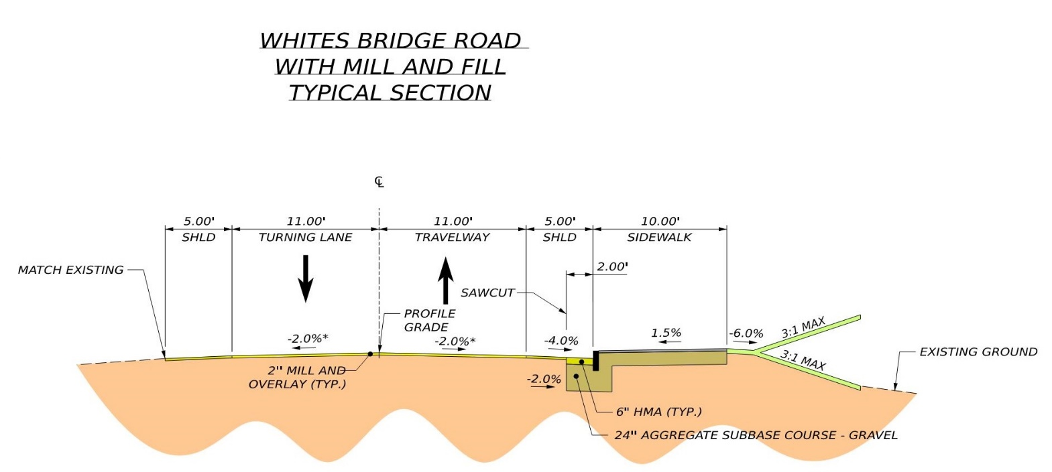
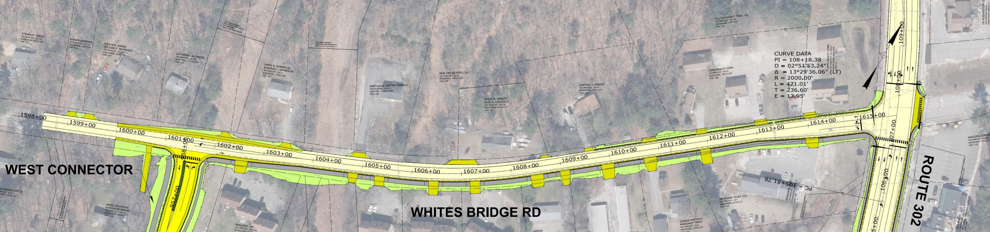
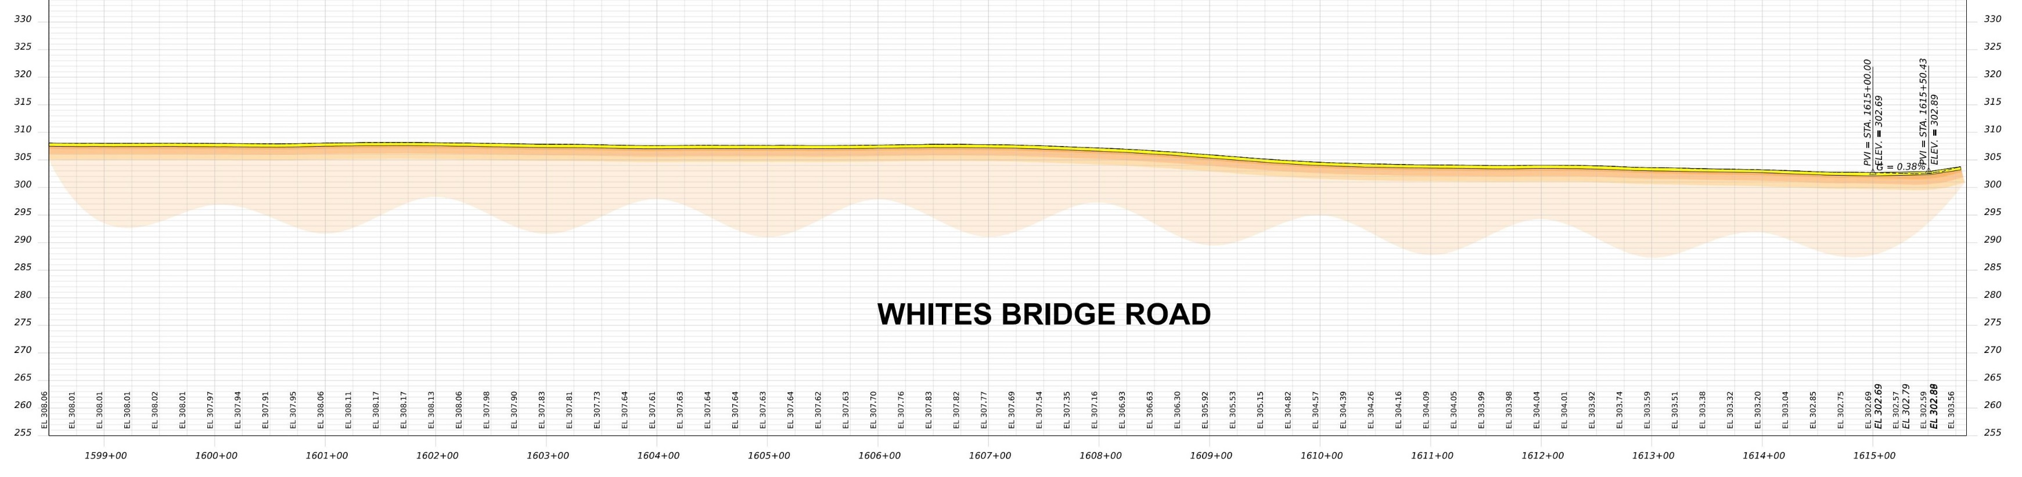
Whites bridge road
N
Notes:
Mill and overlay
11’ TW , 5’+ SH
New 10’ Path on the south side
Roadway widening to provide left turn onto West connector

Slide 24
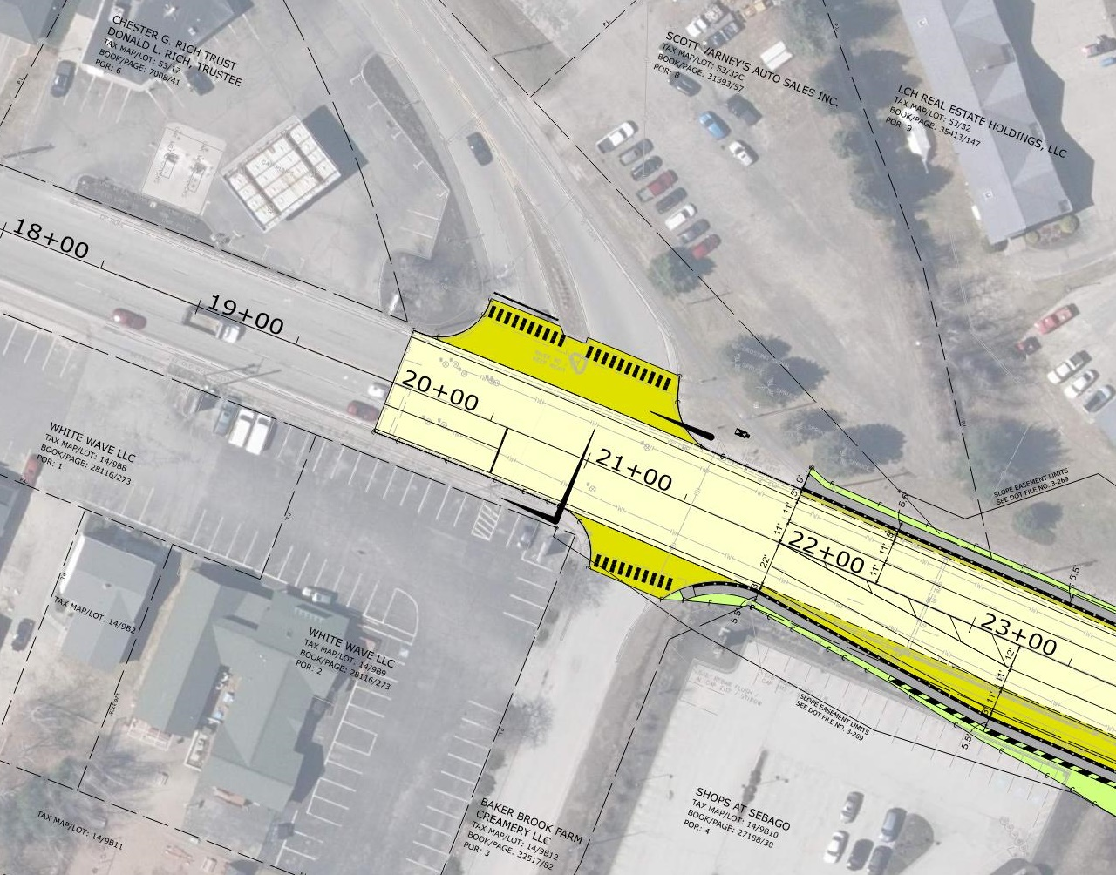
Route 302 & River road
N
Notes:
New traffic and pedestrian signal (adaptive signals equipped with emergency vehicle preemption.)

Slide 25
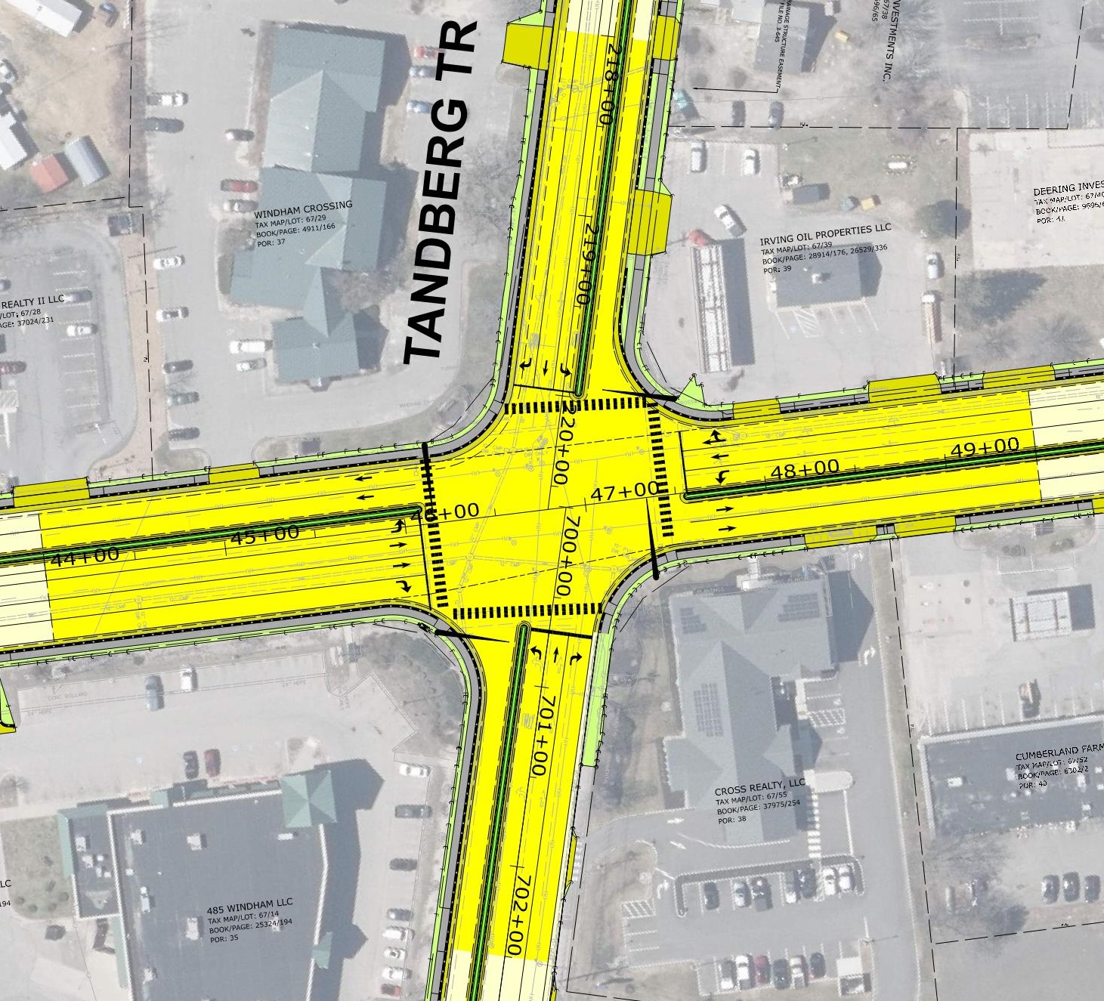
Route 302 & Tandberg trail
N
Notes:
Update traffic and pedestrian signal
Raised median islands
Full depth pavement removal

Slide 26
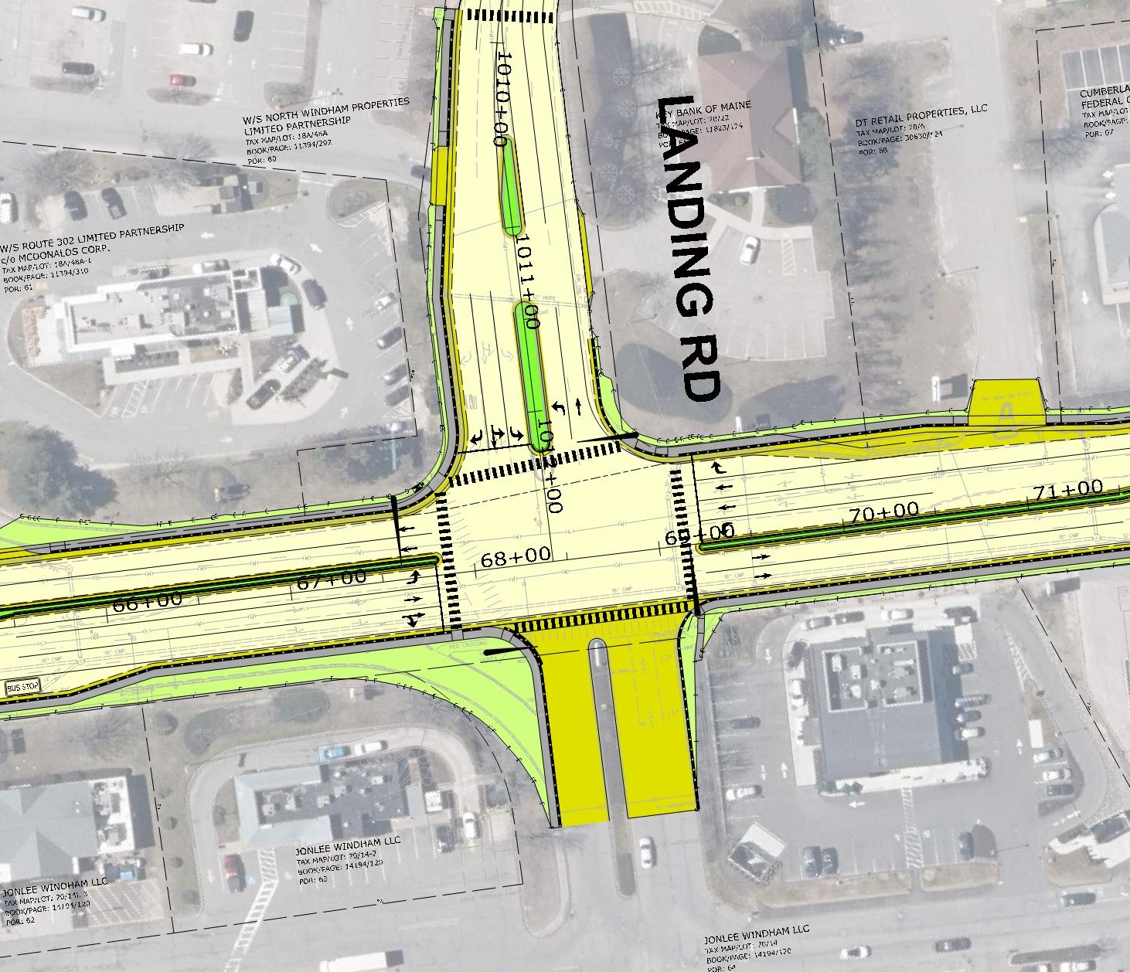
Route 302 & Landing road
N
Notes:
Update traffic and pedestrian signal
Raised median islands
Remove the right turn slip lane
Windham Mall – remove slip lane

Slide 27
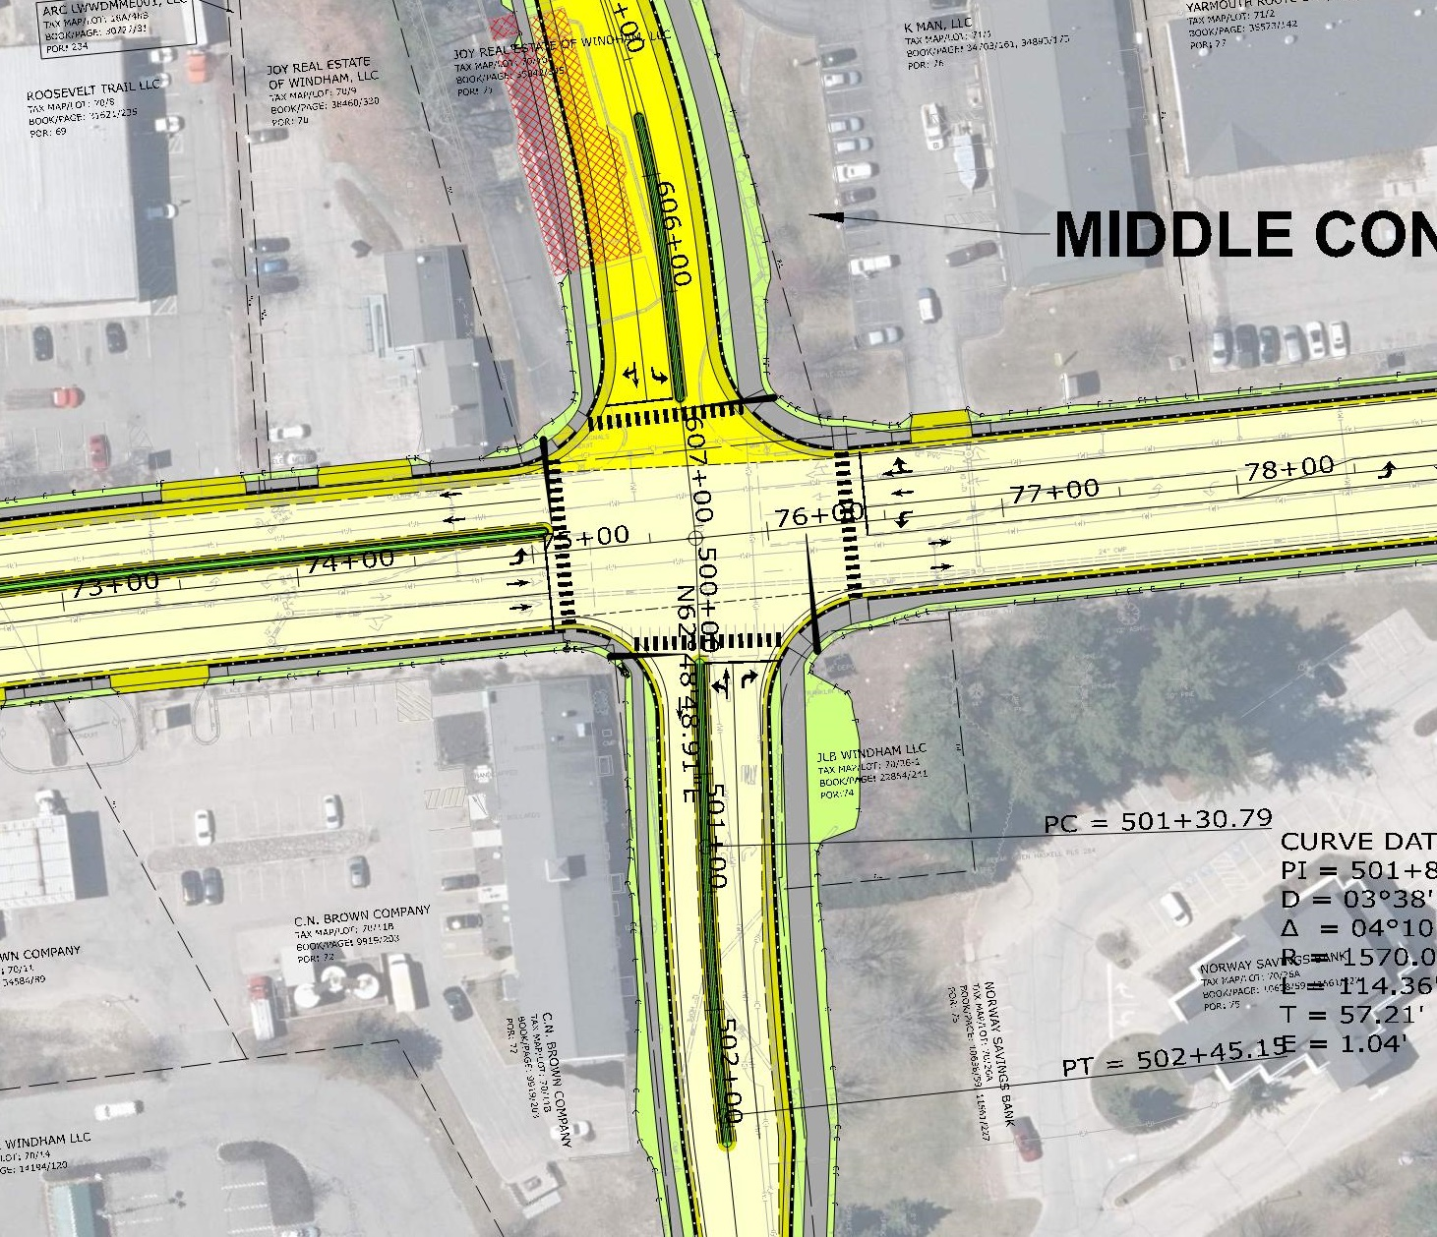
Route 302 & franklin drive & middle connector
N
Notes:
Update traffic and pedestrian signal
New forth leg of the intersection for the Middle Connector
New shared-use path x-ing
Raised median islands

Slide 28
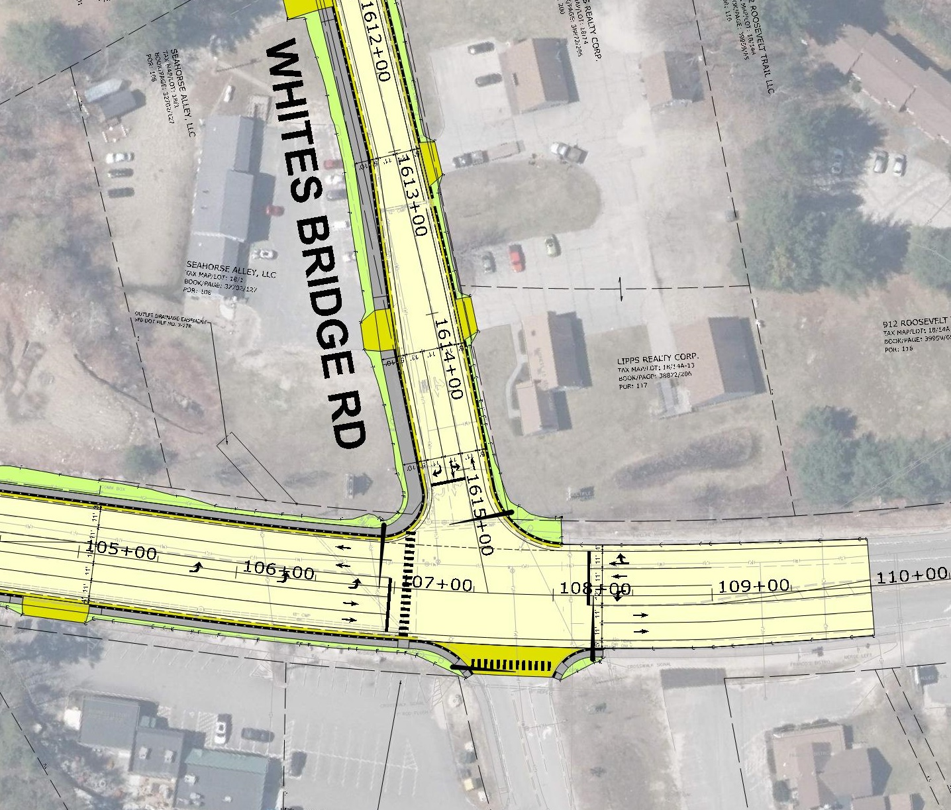
Route 302 & whites bridge road
N
Notes:
Update traffic and pedestrian signal
New shared-use path on Whites Bridge Rd

Slide 29
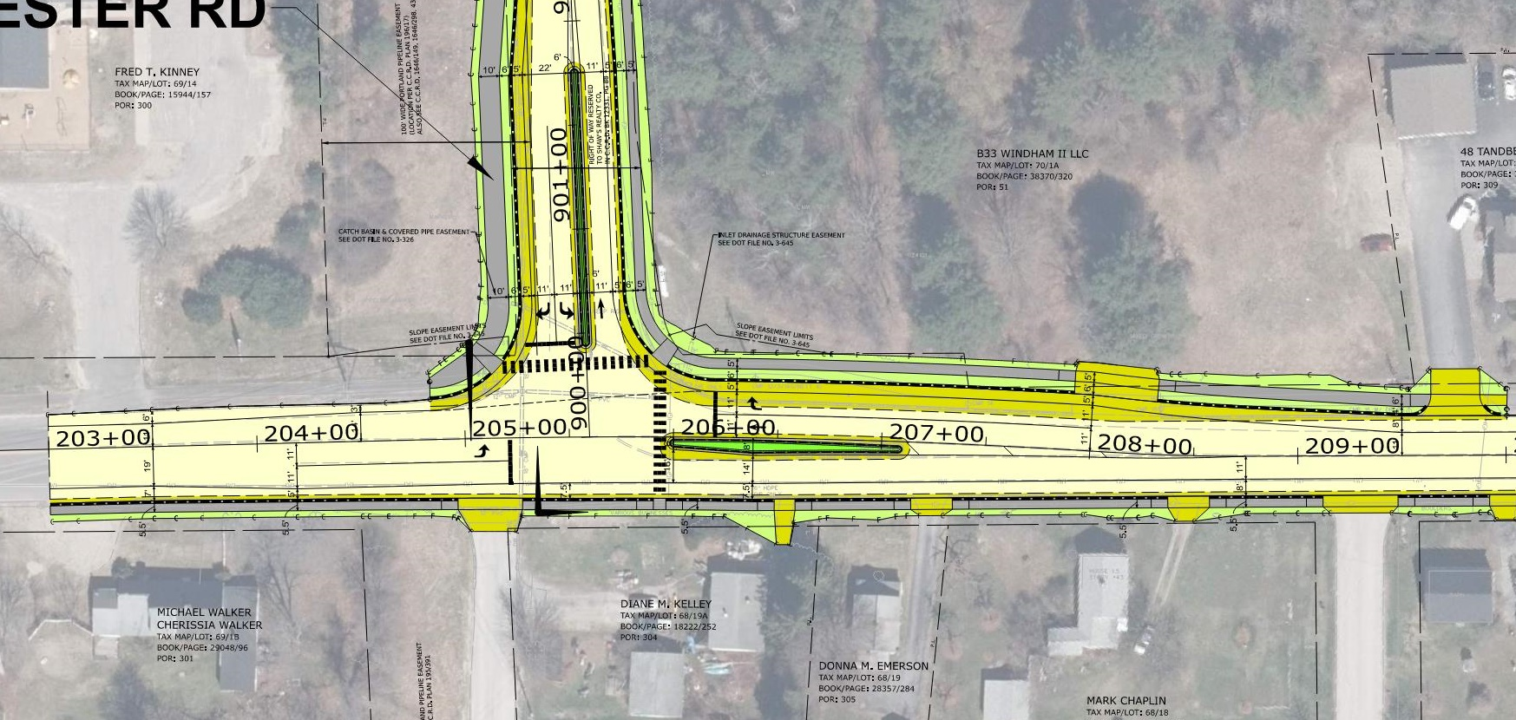
Tandberg trail & west connector
N
Notes:
New traffic and pedestrian signal
Maintain existing raised median islands
Widen roadway for right-turn lane
New shared-use path on Manchester/West Connecter

Slide 30
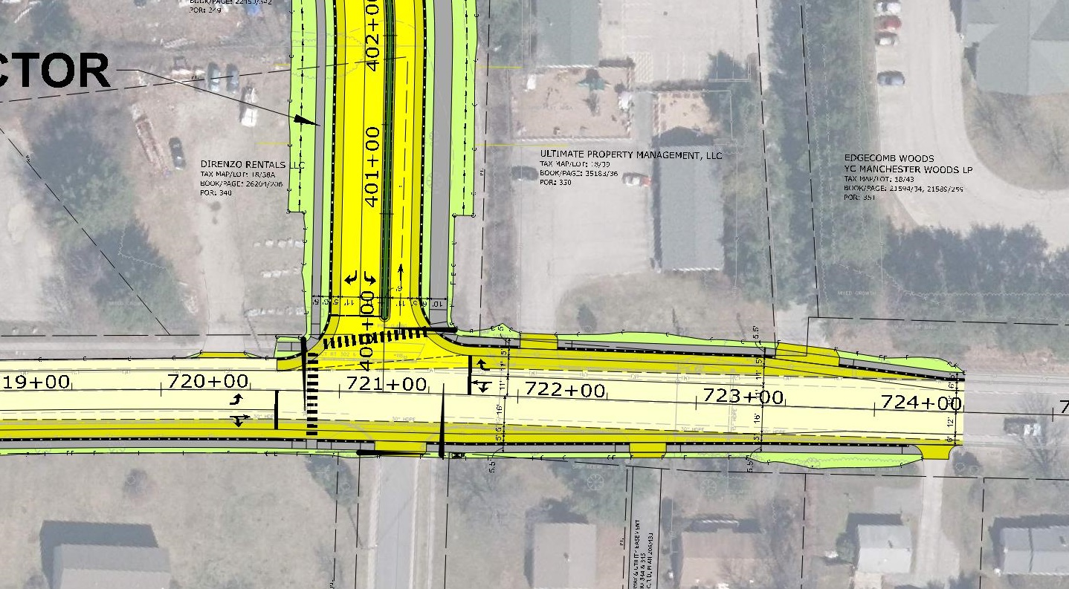
Tandberg trail & east connector
N
Notes:
New traffic and pedestrian signal
New forth leg of the intersection (Dunridge Cir)
East Connector will have a raised median island
New shared-use path on East Connecter

Slide 31
Timeline & Communications
Project Schedule
  Tonight – Preliminary Public Meeting
  February 2025 – Formal Public Meeting
  June 2027 – Project Advertise
  Fall 2027 – Construction Begins
  Fall 2030 – Construction Complete
Notes:
Ernie

Slide 32
Timeline & Communications
Project Funding
  Federal RAISE Grant (80%)
  State (10%)
  Town of Windham (10%)
Notes:
Ernie

Slide 33
Discussion
Ground Rules:
Ground rules- Please raise your hand, when called upon, please go to the podium state your name and address and who you are representing. One person at a time.
Notes:
Ernie

